Slide 1
Federal Users Lessons 1-6: Introduction to CAHMPAS
CAHMPAS Team
North Carolina Rural Health Research and Policy Analysis Center
Cecil G. Sheps Center for Health Services Research
monitoring@flexmonitoring.org
This tutorial was developed by the Flex Monitoring Team with funding from the Federal Office of Rural Health Policy (FOHRP), Health Resources and Service Administration (HRSA), U.S. Department of Health and Human Services (HHS), under PHS Grant No. U27RH01080. The information, conclusions, and opinions expressed in this tutorial are those of the authors, and no endorsement by FORHP, HRSA, or HHS is intended or should be inferred.

Slide 2
AGENDA
Lesson 1: Introduction to CAHMPAS
Lesson 2: Comparing Individual Hospitals Tool
Lesson 3: Comparing Group Trends Tool
Lesson 4: Comparing Relative Indicators Tool
Lesson 5: Downloading Data Tool
Lesson 6: Financial Distress Index

Slide 3
OBJECTIVES
Understand the purpose of CAHMPAS
Choose the appropriate tool for your needs
Make comparisons and utilize medians, benchmarks and peer groups
Save your data and visuals for later use
Use these tools to make more informed decisions with CAHs

Slide 4
Lesson 1 Introduction
Lesson 2 Comparing Individual Hospitals
Lesson 3 Comparing Group Trends
Lesson 4 Comparing Indicators
Lesson 5 Downloading Data
Lesson 6 Financial Distress Index
Federal Users Lesson 1
Introduction to CAHMPAS

Slide 5
What is CAHMPAS?
Lesson 1 Introduction
Lesson 2 Comparing Individual Hospitals
Lesson 3 Comparing Group Trends
Lesson 4 Comparing Indicators
Lesson 5 Downloading Data
Lesson 6 Financial Distress Index
CAHMPAS is a free tool developed by the Flex Monitoring Team to help you:
Identify areas of strength and weakness for CAHs in various states
Explore financial, quality and community benefit performance data for these hospitals
Compare that data across peer groups
Compare that data to state and national medians
Examine resourcing needs of CAHs

Slide 6
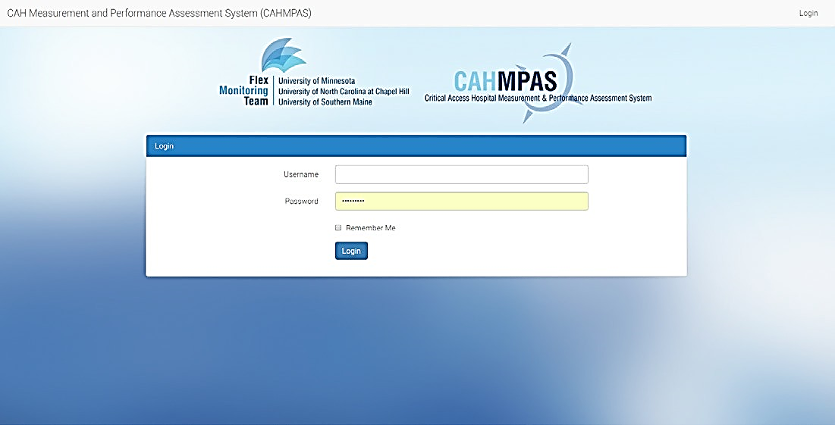
Lesson 1 Introduction
Lesson 2 Comparing Individual Hospitals
Lesson 3 Comparing Group Trends
Lesson 4 Comparing Indicators
Lesson 5 Downloading Data
Lesson 6 Financial Distress Index
1) Log In
Visit http://cahmpas.sirs.unc.edu
Enter your username and password on the screen to your right
Contact monitoring@flexmonitoring.org if you do not know your username and password

Slide 7
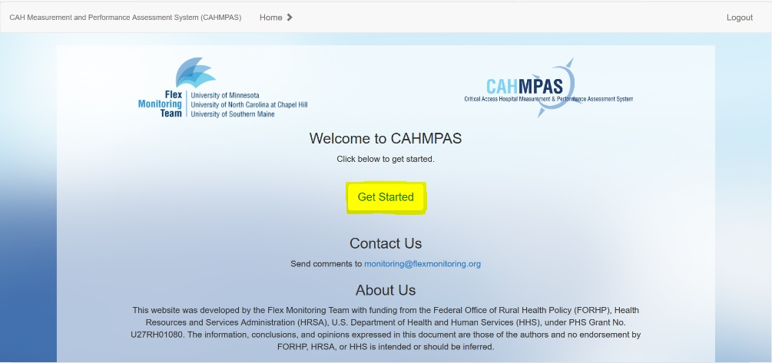
Lesson 1 Introduction
Lesson 2 Comparing Individual Hospitals
Lesson 3 Comparing Group Trends
Lesson 4 Comparing Indicators
Lesson 5 Downloading Data
Lesson 6 Financial Distress Index
2) Get Started
This is the CAHMPAS home page
Navigate back to this page at any time by clicking the home button on the grey navigation bar
Click the yellow, highlighted ‘Get Started’ button to begin.

Slide 8
Lesson 1 Introduction
Lesson 2 Comparing Individual Hospitals
Lesson 3 Comparing Group Trends
Lesson 4 Comparing Indicators
Lesson 5 Downloading Data
Lesson 6 Financial Distress Index
Federal Users Lesson 2
Comparing Individual Hospitals Tool

Slide 9
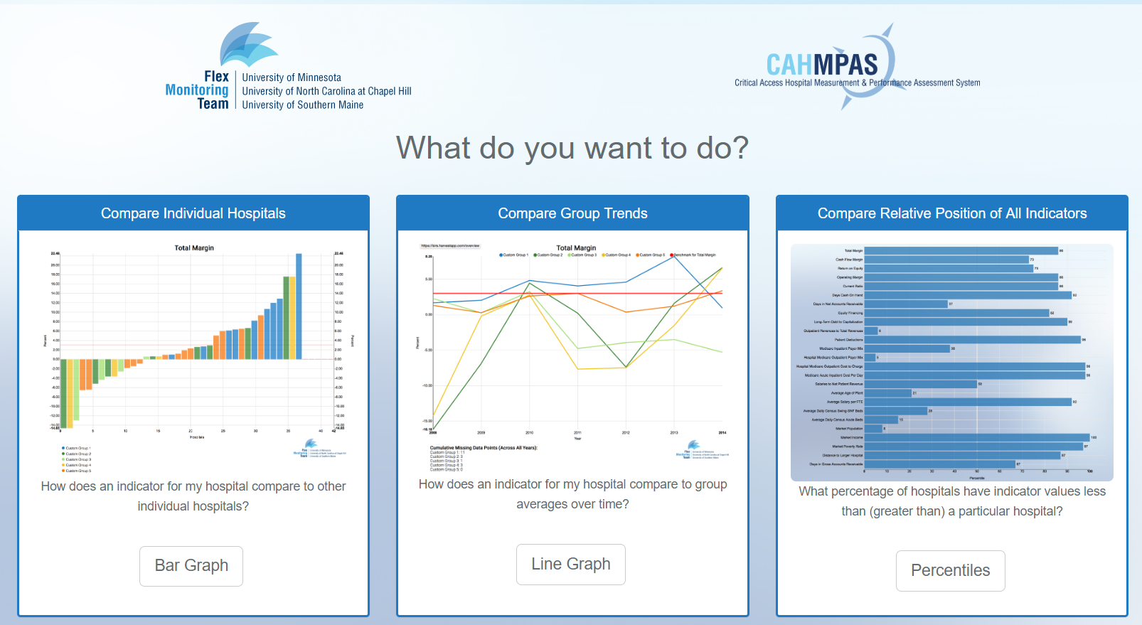
Lesson 1 Introduction
Lesson 2 Comparing Individual Hospitals
Lesson 3 Comparing Group Trends
Lesson 4 Comparing Indicators
Lesson 5 Downloading Data
Lesson 6 Financial Distress Index
1) Select a Graph Type
There are three primary graph types:
Compare individual hospitals using a bar graph
Compare group trends using a line graph
Compare relative position of all indicators using a percentile bar graph
Let’s start with the yellow highlighted bar graph

Slide 10
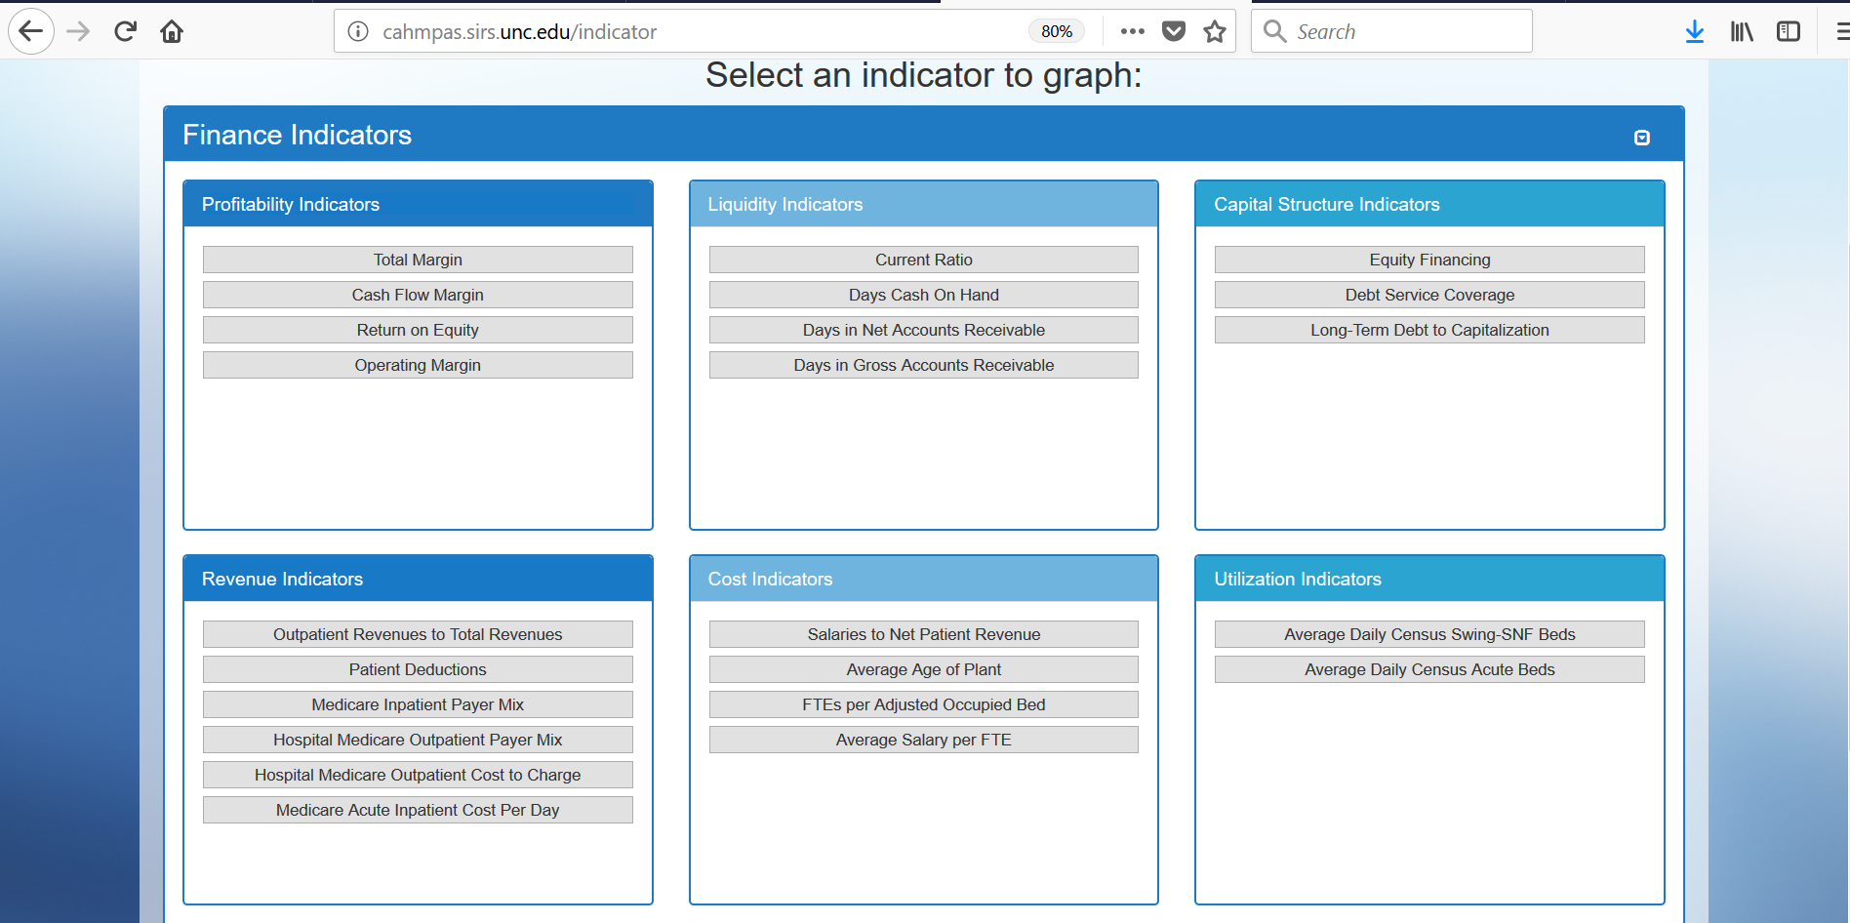
Lesson 1 Introduction
Lesson 2 Comparing Individual Hospitals
Lesson 3 Comparing Group Trends
Lesson 4 Comparing Indicators
Lesson 5 Downloading Data
Lesson 6 Financial Distress Index
2a) Select an Indicator
Choose a category of financial measures or ratios
Profitability
Liquidity
Capital structure
Revenue
Cost
Utilization
Let’s take a look at a common profitability indicator -- operating margin
*See the Financial Analysis Primer for more information on what these indicators capture by visiting here

Slide 11
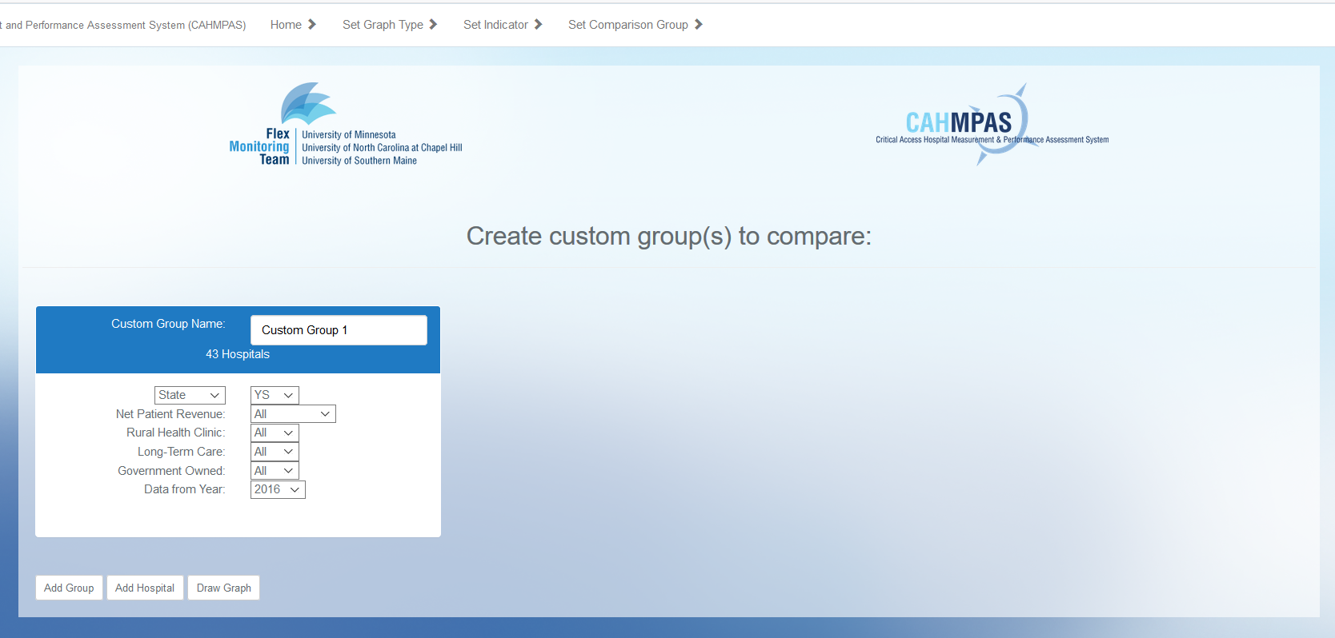
Lesson 1 Introduction
Lesson 2 Comparing Individual Hospitals
Lesson 3 Comparing Group Trends
Lesson 4 Comparing Indicators
Lesson 5 Downloading Data
Lesson 6 Financial Distress Index
2b) Select Your Data
Alter the characteristics of the custom group automatically generated for you
Add an individual hospital to your graph by clicking “Add Hospital”
Add additional groups of like-hospitals by clicking the “Add Group” button

Slide 12
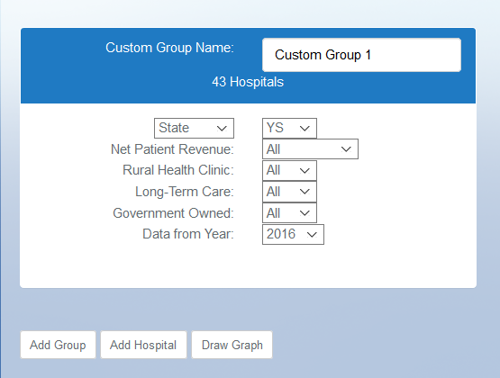
Lesson 1 Introduction
Lesson 2 Comparing Individual Hospitals
Lesson 3 Comparing Group Trends
Lesson 4 Comparing Indicators
Lesson 5 Downloading Data
Lesson 6 Financial Distress Index
3) Select a Custom Group
Select the scope (state, region, national)
Select specific region or state
Select a net patient revenue
Answer Yes/No/Both to the following:
Run a rural health clinic?
Provide long-term care?
Owned by the government?
Select a data year
Name your custom group
Add any additional groups by clicking “Add Group”

Slide 13
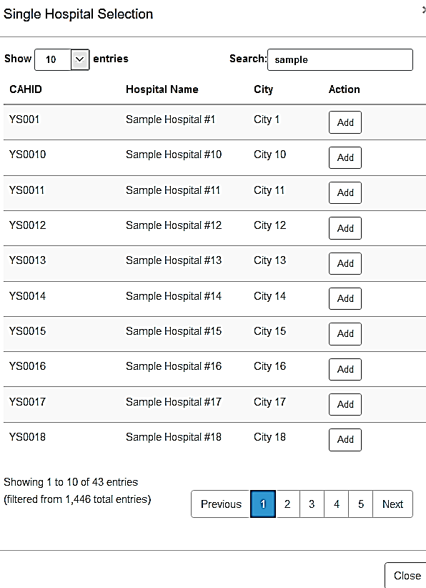
Lesson 1 Introduction
Lesson 2 Comparing Individual Hospitals
Lesson 3 Comparing Group Trends
Lesson 4 Comparing Indicators
Lesson 5 Downloading Data
Lesson 6 Financial Distress Index
4) Select an Individual Hospital
Add an individual hospital to your graph by pressing “Add Hospital”
Select the hospital from the list provided
Use the search bar at the top of the list to filter results
Click “Add”
Add any additional groups or hospitals
Click “Draw graph”

Slide 14
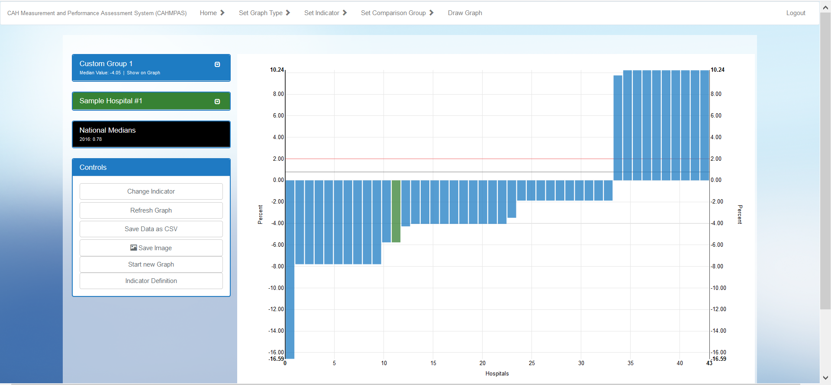
Lesson 1 Introduction
Lesson 2 Comparing Individual Hospitals
Lesson 3 Comparing Group Trends
Lesson 4 Comparing Indicators
Lesson 5 Downloading Data
Lesson 6 Financial Distress Index
5a) Bar Graph: Overview
Individual Hospital
Custom Group

Slide 15
Lesson 1 Introduction
Lesson 2 Comparing Individual Hospitals
Lesson 3 Comparing Group Trends
Lesson 4 Comparing Indicators
Lesson 5 Downloading Data
Lesson 6 Financial Distress Index
5b) Bar Graph: Benchmarks
CAH Benchmark
US Median

Slide 16
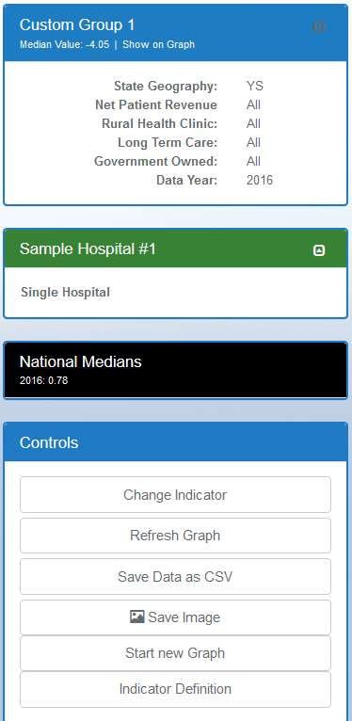
Lesson 1 Introduction
Lesson 2 Comparing Individual Hospitals
Lesson 3 Comparing Group Trends
Lesson 4 Comparing Indicators
Lesson 5 Downloading Data
Lesson 6 Financial Distress Index
6a) Bar Graph: Side Bars
Custom Group’s Details
Individual Hospital’s Details
Control, Print or Export your Graph

Slide 17
Lesson 1 Introduction
Lesson 2 Comparing Individual Hospitals
Lesson 3 Comparing Group Trends
Lesson 4 Comparing Indicators
Lesson 5 Downloading Data
Lesson 6 Financial Distress Index
6b) Bar Graph: Controls
Change Graph’s Indicator
Export Graph to Excel
Save Image as JPG or PDF
Return to Chart Selection
Explanation of Indicator

Slide 18
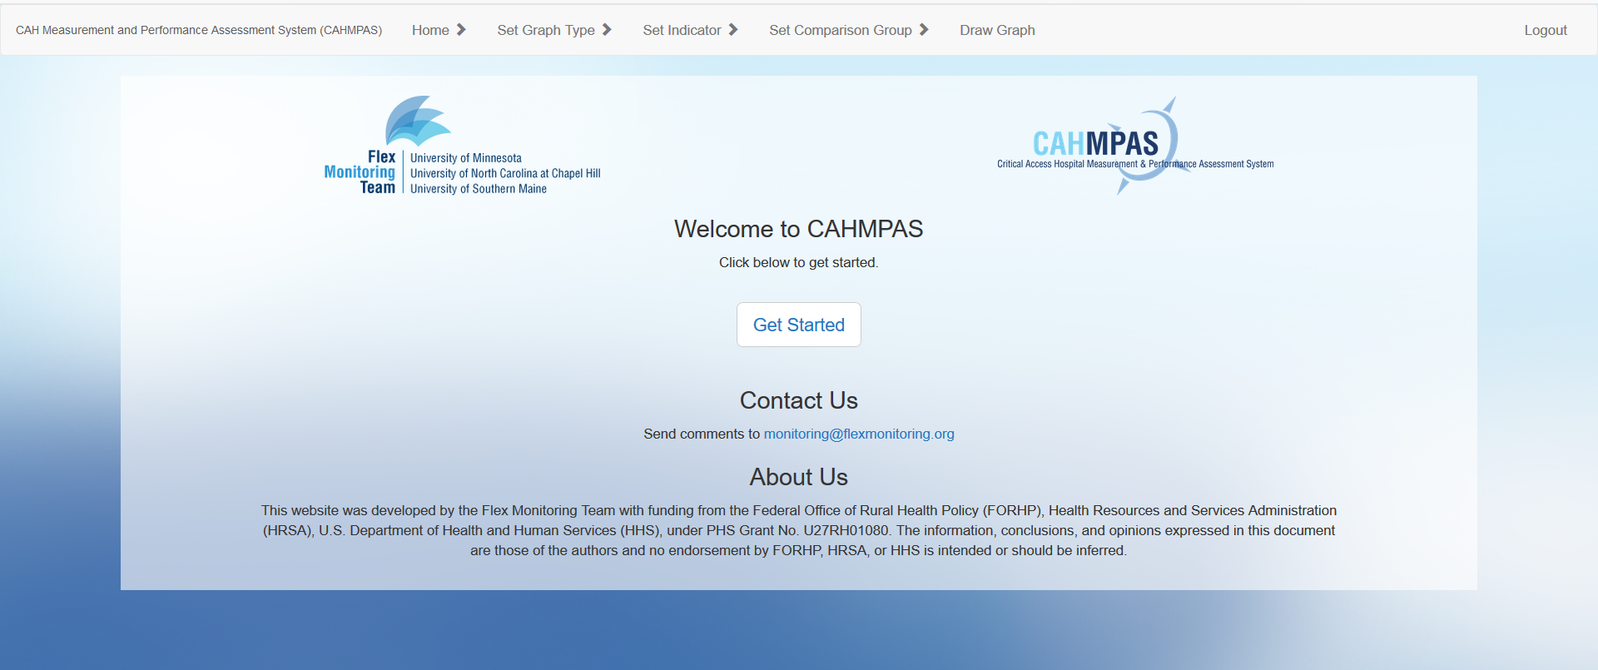
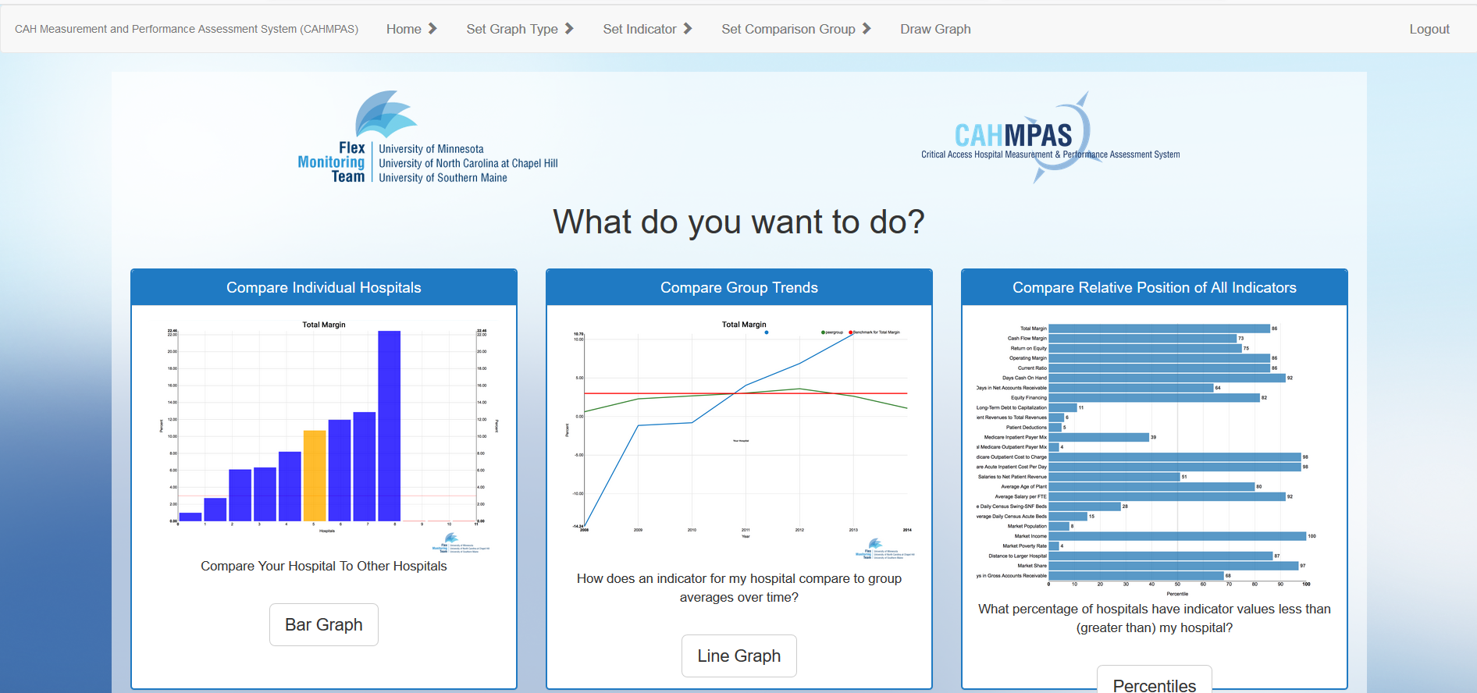
Lesson 1 Introduction
Lesson 2 Comparing Individual Hospitals
Lesson 3 Comparing Group Trends
Lesson 4 Comparing Indicators
Lesson 5 Downloading Data
Lesson 6 Financial Distress Index
7) Return to a Previous Page
This navigation bar allows you to return to those screens by clicking any of the options above.
Home Page
Graph Selection

Slide 19
Lesson 1 Introduction
Lesson 2 Comparing Individual Hospitals
Lesson 3 Comparing Group Trends
Lesson 4 Comparing Indicators
Lesson 5 Downloading Data
Lesson 6 Financial Distress Index
Federal Users Lesson 3
Comparing Group Trends Tool

Slide 20
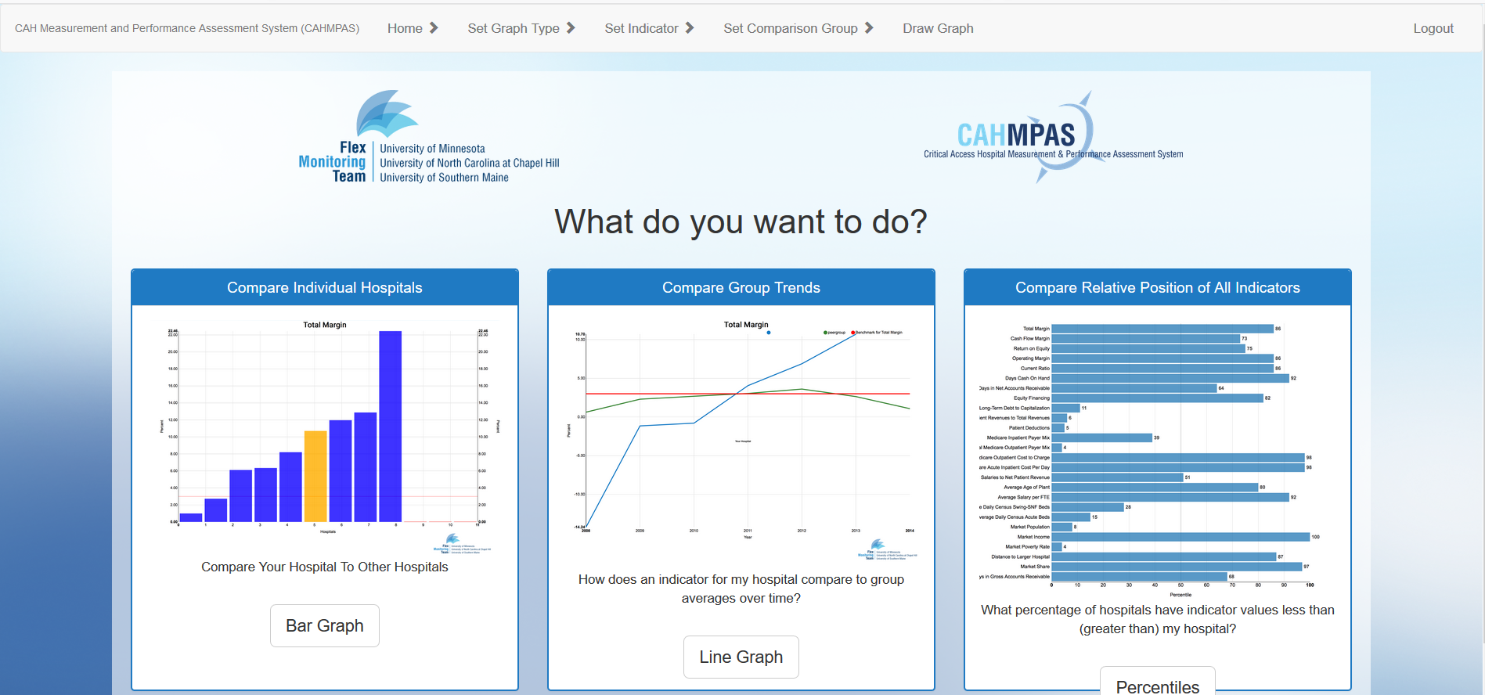
Lesson 1 Introduction
Lesson 2 Comparing Individual Hospitals
Lesson 3 Comparing Group Trends
Lesson 4 Comparing Indicators
Lesson 5 Downloading Data
Lesson 6 Financial Distress Index
1) Return to Graph Type
Select “Set Graph Type” from your grey navigation bar
Recall there are three primary graph types:
Compare individual hospitals using a bar graph
Compare group trends using a line graph
Compare relative position of all indicators using a percentile bar graph
Let’s begin by selecting the yellow highlighted line graph

Slide 21
Lesson 1 Introduction
Lesson 2 Comparing Individual Hospitals
Lesson 3 Comparing Group Trends
Lesson 4 Comparing Indicators
Lesson 5 Downloading Data
Lesson 6 Financial Distress Index
2) Select an Indicator & Comparison
Choose an indicator to graph
Use automatically generated custom groups from your previous graph or create new groups to compare
Click “Draw Graph”

Slide 22
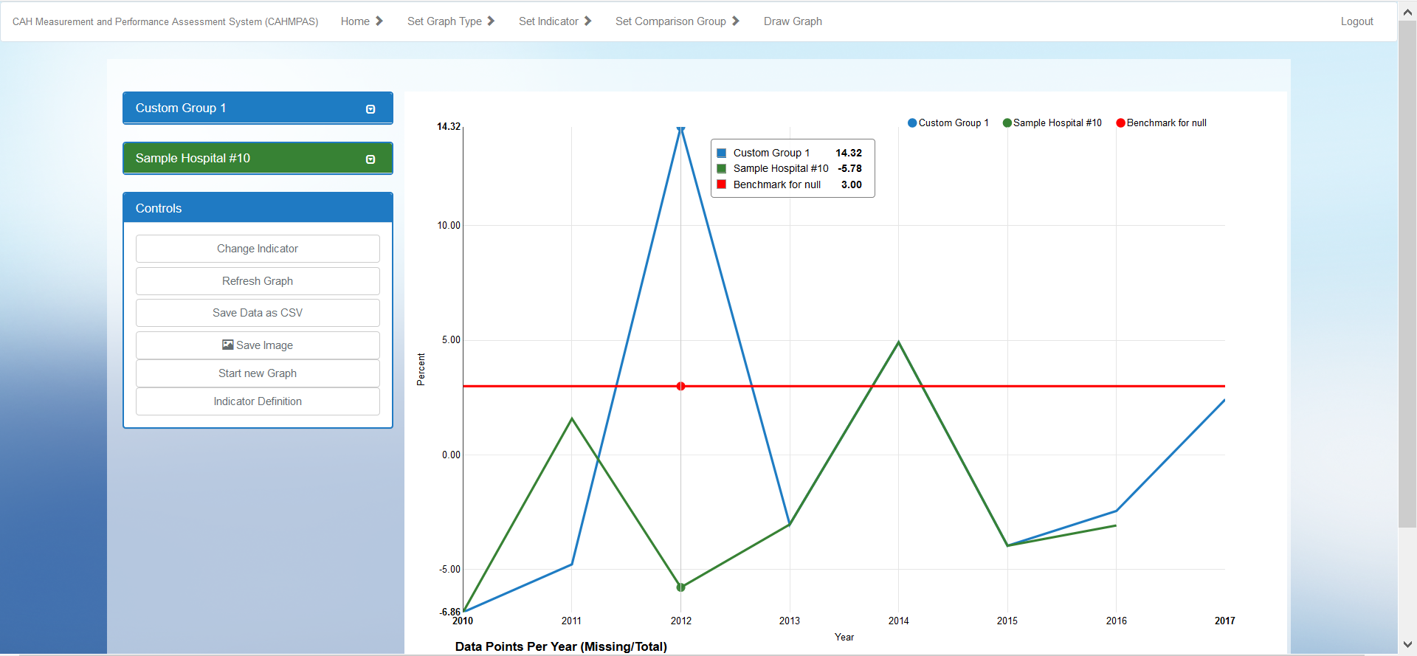
Lesson 1 Introduction
Lesson 2 Comparing Individual Hospitals
Lesson 3 Comparing Group Trends
Lesson 4 Comparing Indicators
Lesson 5 Downloading Data
Lesson 6 Financial Distress Index
3a) Line Graph: Overview
Custom Group
Benchmark
Individual Hospital

Slide 23
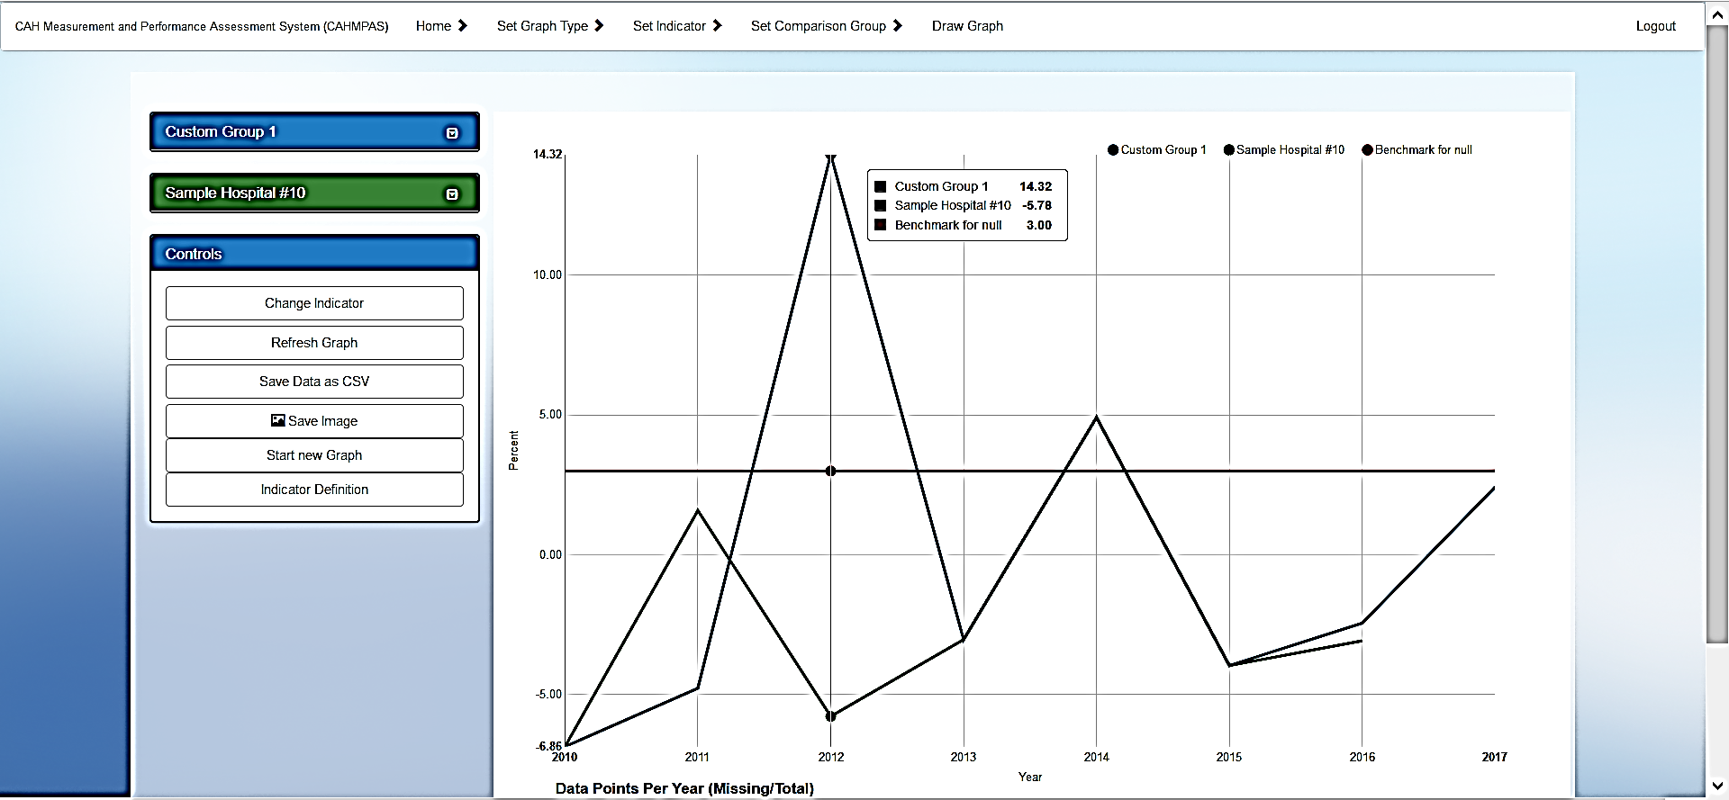
Lesson 1 Introduction
Lesson 2 Comparing Individual Hospitals
Lesson 3 Comparing Group Trends
Lesson 4 Comparing Indicators
Lesson 5 Downloading Data
Lesson 6 Financial Distress Index
3b) Line Graph: Benchmarks
Hover over or near the lines in order to see the indicator pop-up box
See values for:
Custom Groups
Individual Hospitals
Benchmark

Slide 24
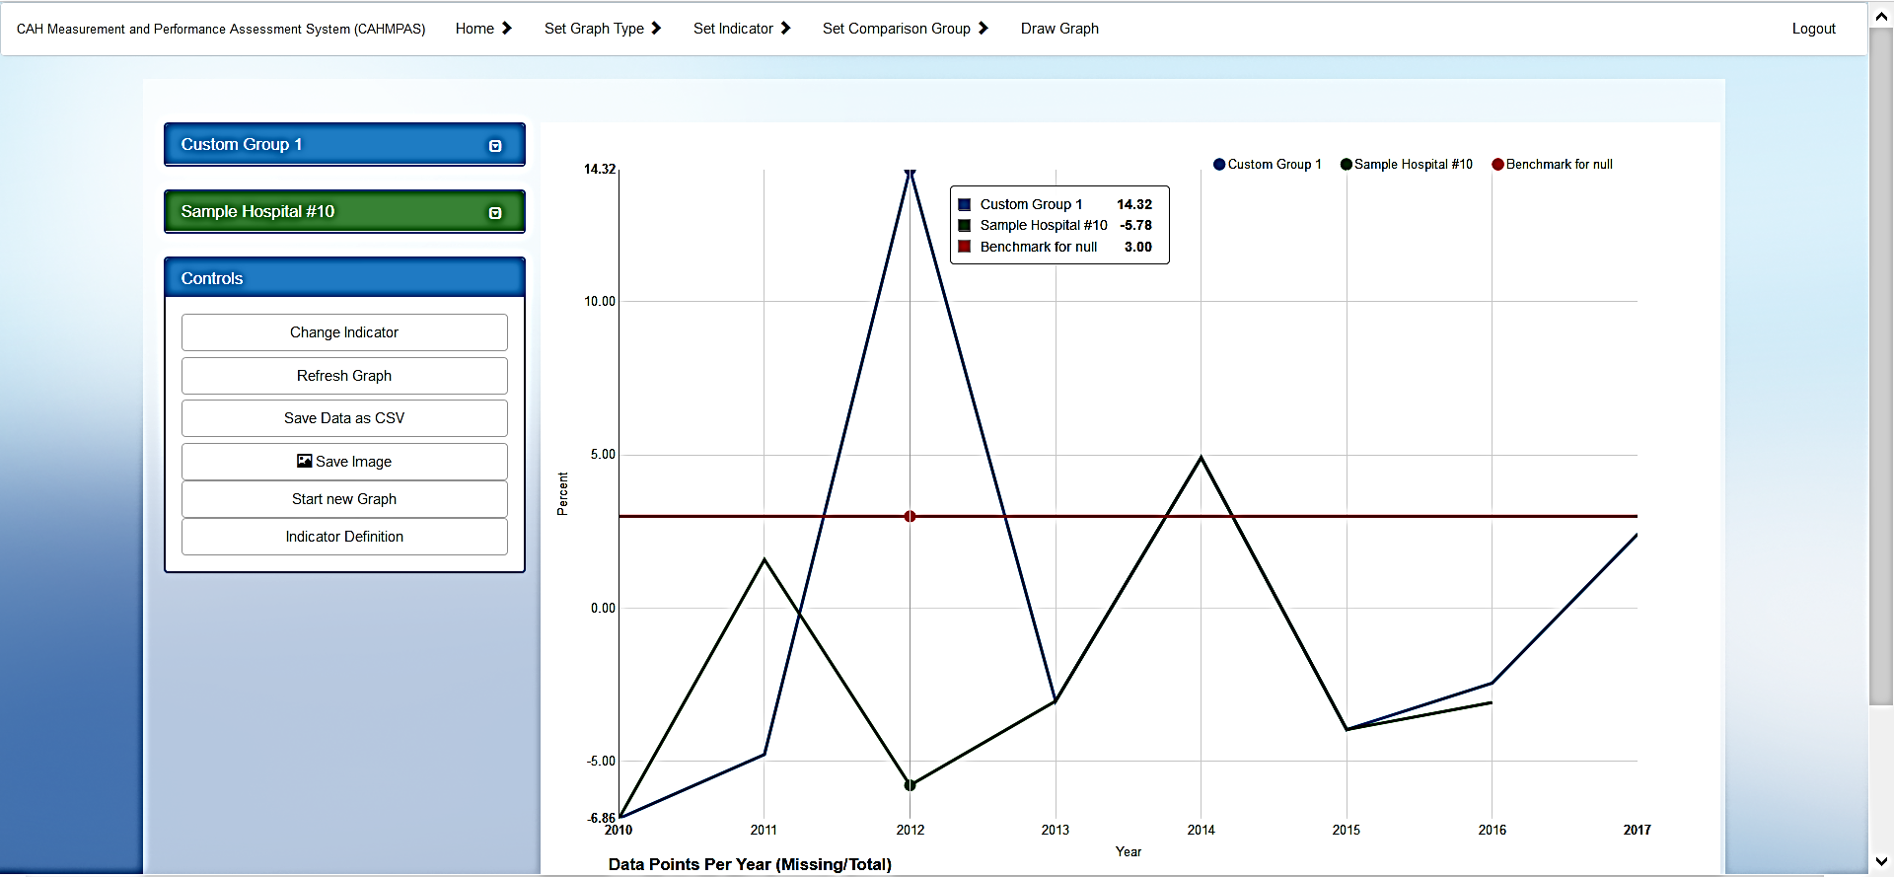
Lesson 1 Introduction
Lesson 2 Comparing Individual Hospitals
Lesson 3 Comparing Group Trends
Lesson 4 Comparing Indicators
Lesson 5 Downloading Data
Lesson 6 Financial Distress Index
4a) Line Graph: Controls
These controls appear with every graph type

Slide 25
Lesson 1 Introduction
Lesson 2 Comparing Individual Hospitals
Lesson 3 Comparing Group Trends
Lesson 4 Comparing Indicators
Lesson 5 Downloading Data
Lesson 6 Financial Distress Index
4b) Line Graph: Export data
Return to CAHMPAS controls box
Click ‘Save Data as CSV’
Export Graph to Excel

Slide 26
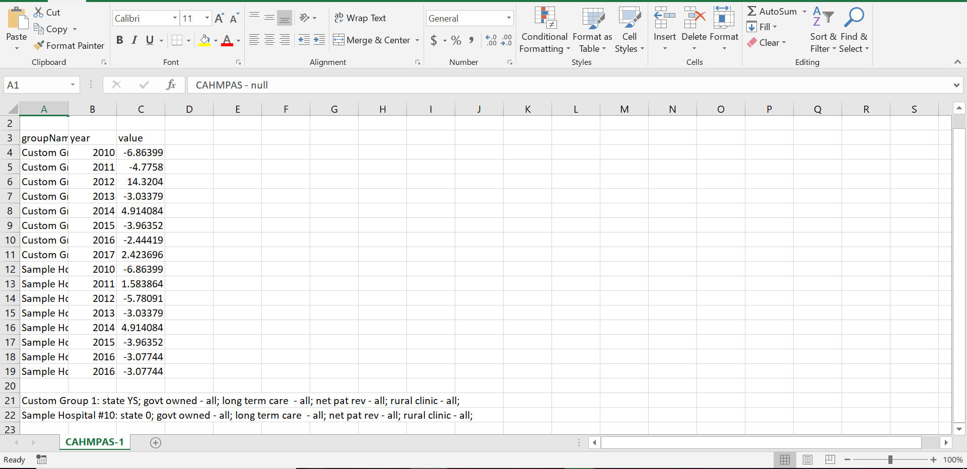
Lesson 1 Introduction
Lesson 2 Comparing Individual Hospitals
Lesson 3 Comparing Group Trends
Lesson 4 Comparing Indicators
Lesson 5 Downloading Data
Lesson 6 Financial Distress Index
4c) Line Graph: Export output
You receive data for both your custom groups and the individual hospitals, in order by year
Characteristics/filters chosen for your custom group(s) are shown at the bottom of the sheet, as a reminder
See row 21 & 22

Slide 27
Lesson 1 Introduction
Lesson 2 Comparing Individual Hospitals
Lesson 3 Comparing Group Trends
Lesson 4 Comparing Indicators
Lesson 5 Downloading Data
Lesson 6 Financial Distress Index
4d) Line graph: Save image
Return to CAHMPAS controls box
Click ‘Save Image’
Save Image as JPG or PNG

Slide 28
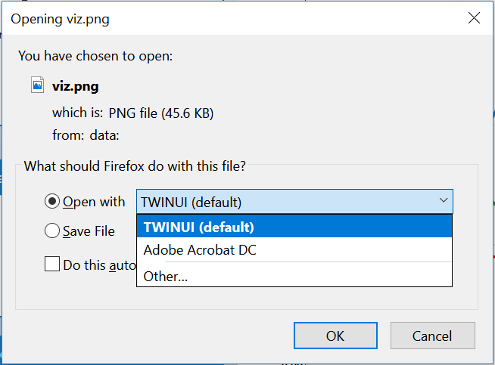
Lesson 1 Introduction
Lesson 2 Comparing Individual Hospitals
Lesson 3 Comparing Group Trends
Lesson 4 Comparing Indicators
Lesson 5 Downloading Data
Lesson 6 Financial Distress Index
4e) Line Graph: Open image
PCs: do not open images with the default application TWINUI
Instead, select a PDF viewer or Windows Photo Viewer from your open file options
Save as PDF or as another type of file from that platform
To save as JPEG, go to File → Export To → Image, and choose JPEG

Slide 29
Lesson 1 Introduction
Lesson 2 Comparing Individual Hospitals
Lesson 3 Comparing Group Trends
Lesson 4 Comparing Indicators
Lesson 5 Downloading Data
Lesson 6 Financial Distress Index
5a) Select Indicator Definition
Forget which indicator you selected? Want more information about what graphs mean?
The “Indicator Definition” button will also direct you to a downloadable list of indicator definitions
Click “Indicator Definition”
Explanation of Indicator

Slide 30
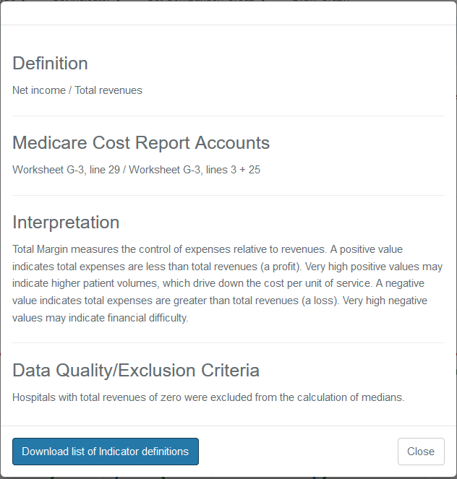
Lesson 1 Introduction
Lesson 2 Comparing Individual Hospitals
Lesson 3 Comparing Group Trends
Lesson 4 Comparing Indicators
Lesson 5 Downloading Data
Lesson 6 Financial Distress Index
5b) Indicator Dialogue Box
When you click “Indicator Definition” the following dialogue box will appear, where you can see:
Definitional Formula
Medicare Formula
Interpretation
Data Information
List of Indicator Definitions (blue button)

Slide 31
Lesson 1 Introduction
Lesson 2 Comparing Individual Hospitals
Lesson 3 Comparing Group Trends
Lesson 4 Comparing Indicators
Lesson 5 Downloading Data
Lesson 6 Financial Distress Index
6) Change Indicator
Change Indicator
Allows you to select a different indicator to view on your line graph
Select finance indicator
Then choose a specific indicator (i.e. Return on Equity)

Slide 32
Lesson 1 Introduction
Lesson 2 Comparing Individual Hospitals
Lesson 3 Comparing Group Trends
Lesson 4 Comparing Indicators
Lesson 5 Downloading Data
Lesson 6 Financial Distress Index
7) Start New Graph
Click ‘Start New Graph’ in order to change the type of graph (bar, line, percentile)
Return to the chart selection page
Return to Chart Selection

Slide 33
Lesson 1 Introduction
Lesson 2 Comparing Individual Hospitals
Lesson 3 Comparing Group Trends
Lesson 4 Comparing Indicators
Lesson 5 Downloading Data
Lesson 6 Financial Distress Index
Federal Users Lesson 4
Comparing Relative Indicators Tool

Slide 34
Lesson 1 Introduction
Lesson 2 Comparing Individual Hospitals
Lesson 3 Comparing Group Trends
Lesson 4 Comparing Indicators
Lesson 5 Downloading Data
Lesson 6 Financial Distress Index
1) Select Percentiles Graph
Recall there are three primary graph types:
Compare individual hospitals using a bar graph
Compare group trends using a line graph
Compare relative position of all indicators using a percentile bar graph
Lastly, let’s select the yellow highlighted percentiles graph

Slide 35
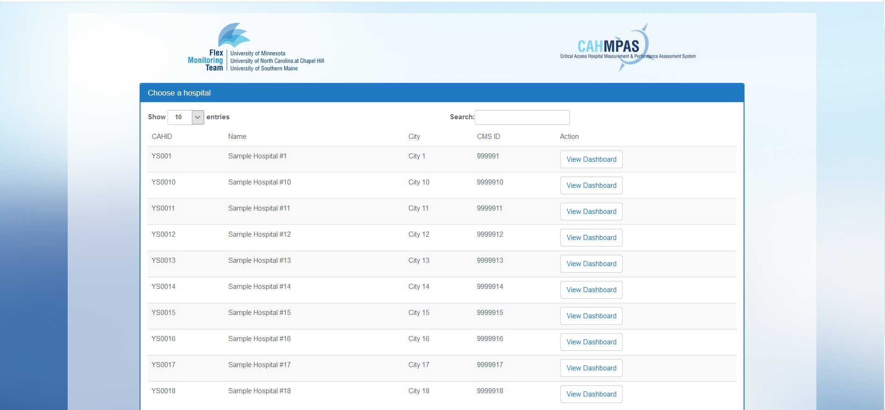
Lesson 1 Introduction
Lesson 2 Comparing Individual Hospitals
Lesson 3 Comparing Group Trends
Lesson 4 Comparing Indicators
Lesson 5 Downloading Data
Lesson 6 Financial Distress Index
2) Percentiles Graph: Select Hospital
Choose a hospital to view its dashboard of finance indicators
Use the search bar to filter results
Click “View Dashboard” in yellow to select a hospital

Slide 36
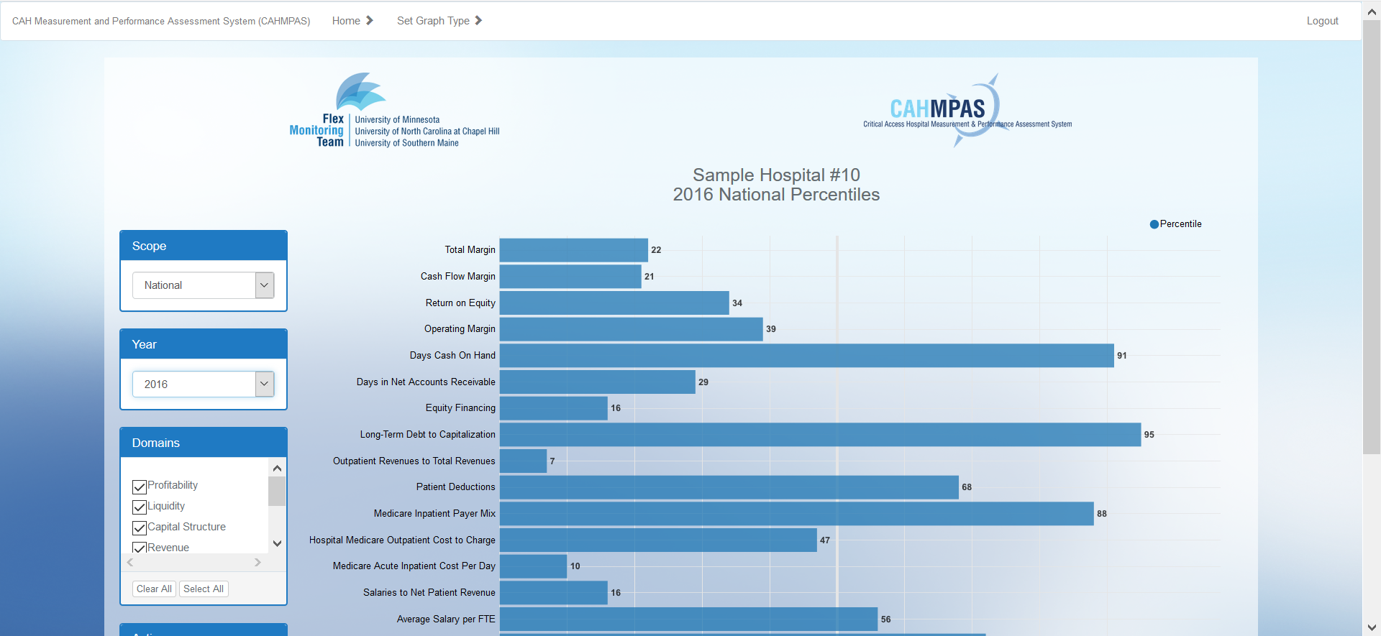
Lesson 1 Introduction
Lesson 2 Comparing Individual Hospitals
Lesson 3 Comparing Group Trends
Lesson 4 Comparing Indicators
Lesson 5 Downloading Data
Lesson 6 Financial Distress Index
3) Percentiles Graph: Overview

Slide 37
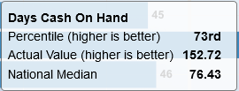
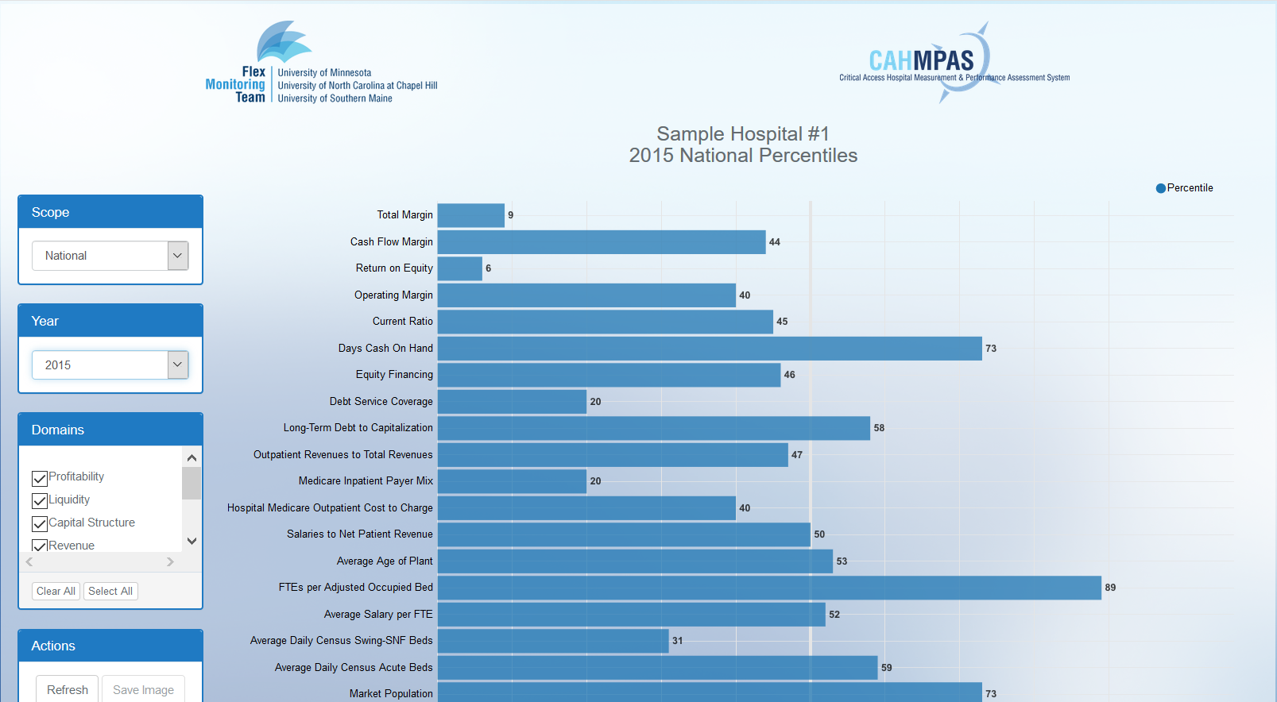
Lesson 1 Introduction
Lesson 2 Comparing Individual Hospitals
Lesson 3 Comparing Group Trends
Lesson 4 Comparing Indicators
Lesson 5 Downloading Data
Lesson 6 Financial Distress Index
4a) Percentiles Graph: Values
Hover over the percentile bars in order to see the indicator pop-up box
See values for:
Hospital’s Indicator Value
Hospital’s Percentile
State/National Median

Slide 38
Lesson 1 Introduction
Lesson 2 Comparing Individual Hospitals
Lesson 3 Comparing Group Trends
Lesson 4 Comparing Indicators
Lesson 5 Downloading Data
Lesson 6 Financial Distress Index
4b) Percentiles Graph: Side Bars
Select a Specific State or All CAHs
Change the Data Year
Display More or Fewer Indicator Types
Alter or Save Your Graph

Slide 39
Lesson 1 Introduction
Lesson 2 Comparing Individual Hospitals
Lesson 3 Comparing Group Trends
Lesson 4 Comparing Indicators
Lesson 5 Downloading Data
Lesson 6 Financial Distress Index
Federal Users Lesson 5
Downloading Data Tool

Slide 40
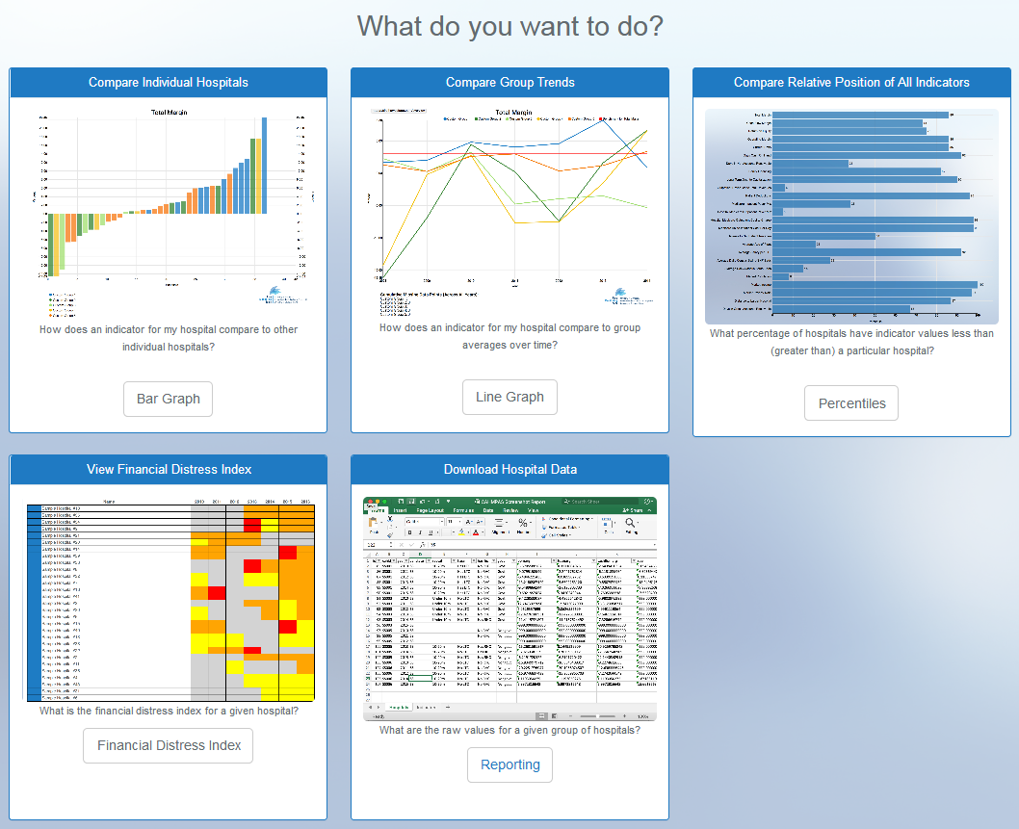
Lesson 1 Introduction
Lesson 2 Comparing Individual Hospitals
Lesson 3 Comparing Group Trends
Lesson 4 Comparing Indicators
Lesson 5 Downloading Data
Lesson 6 Financial Distress Index
1) Select Reporting Tool
Allows us to download the data displayed in the CAHMPAS charts
Scroll down below the three graph types
Select the yellow highlighted reporting button

Slide 41
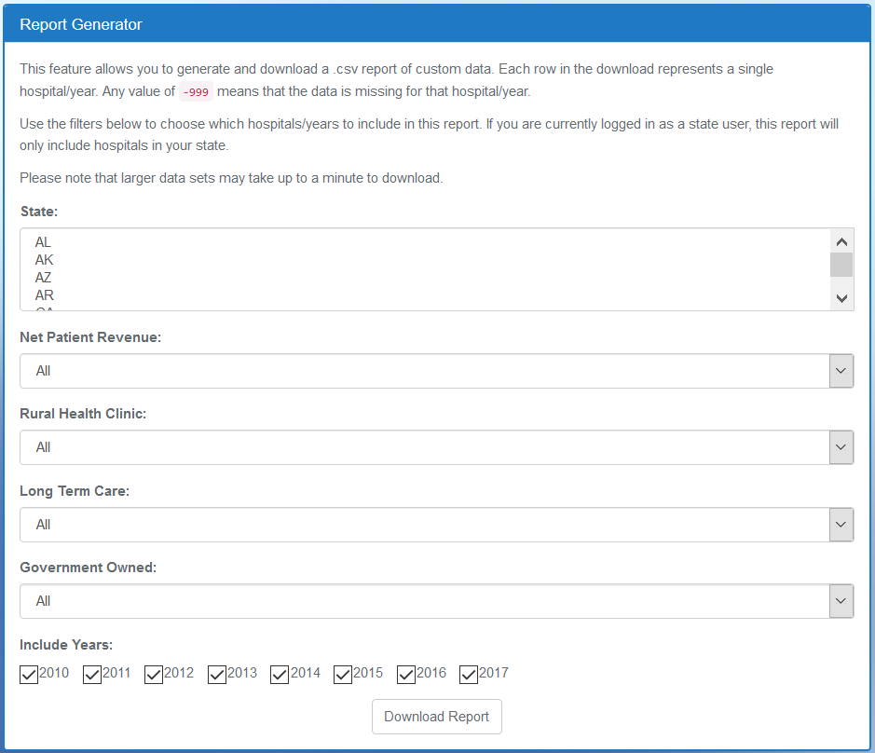
Lesson 1 Introduction
Lesson 2 Comparing Individual Hospitals
Lesson 3 Comparing Group Trends
Lesson 4 Comparing Indicators
Lesson 5 Downloading Data
Lesson 6 Financial Distress Index
2) Report Generator
You may choose to filter the data for your hospitals before download
Choose a state
Choose a net patient revenue
Choose whether the hospitals will have:
Rural health clinics
Long-term care provisions
Government ownership
Choose the years of data

Slide 42
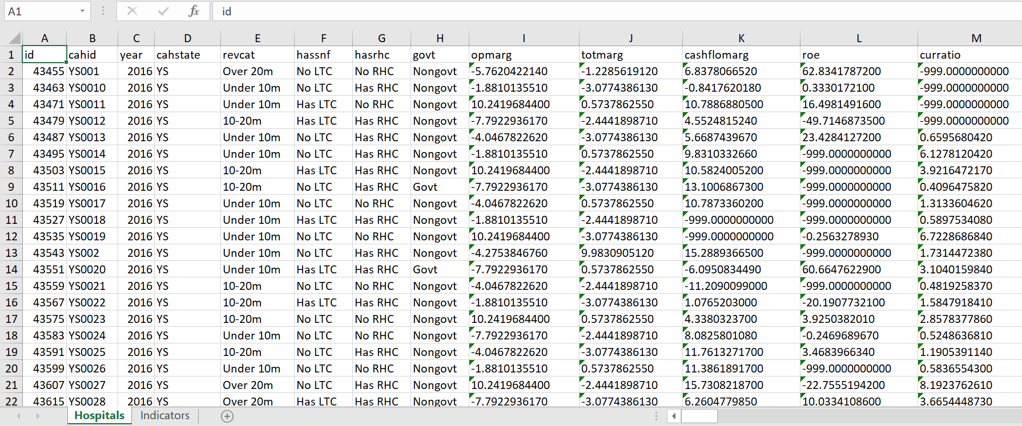
Lesson 1 Introduction
Lesson 2 Comparing Individual Hospitals
Lesson 3 Comparing Group Trends
Lesson 4 Comparing Indicators
Lesson 5 Downloading Data
Lesson 6 Financial Distress Index
3) Data Report
Data is displayed on the “Hospitals” tab
A list of finance indicator definitions is provided on the “Indicators” tab

Slide 43
Lesson 1 Introduction
Lesson 2 Comparing Individual Hospitals
Lesson 3 Comparing Group Trends
Lesson 4 Comparing Indicators
Lesson 5 Downloading Data
Lesson 6 Financial Distress Index
Federal Users Lesson 6
Financial Distress Index

Slide 44
Lesson 1 Introduction
Lesson 2 Comparing Individual Hospitals
Lesson 3 Comparing Group Trends
Lesson 4 Comparing Indicators
Lesson 5 Downloading Data
Lesson 6 Financial Distress Index
1) Select the Financial Distress Index Tool
Another feature of CAHMPAS is the Financial Distress Index.
The Financial Distress Index Model (FDI) predicts the probability of rural hospital financial distress and subsequent closure within two years.
Select Financial Distress Index
For more info on how the model works, read: GM Holmes, BG Kaufman and GH Pink. Predicting Financial Distress in Rural Hospitals, Journal of Rural Health, Summer 2017;33(3):239-249.

Slide 45
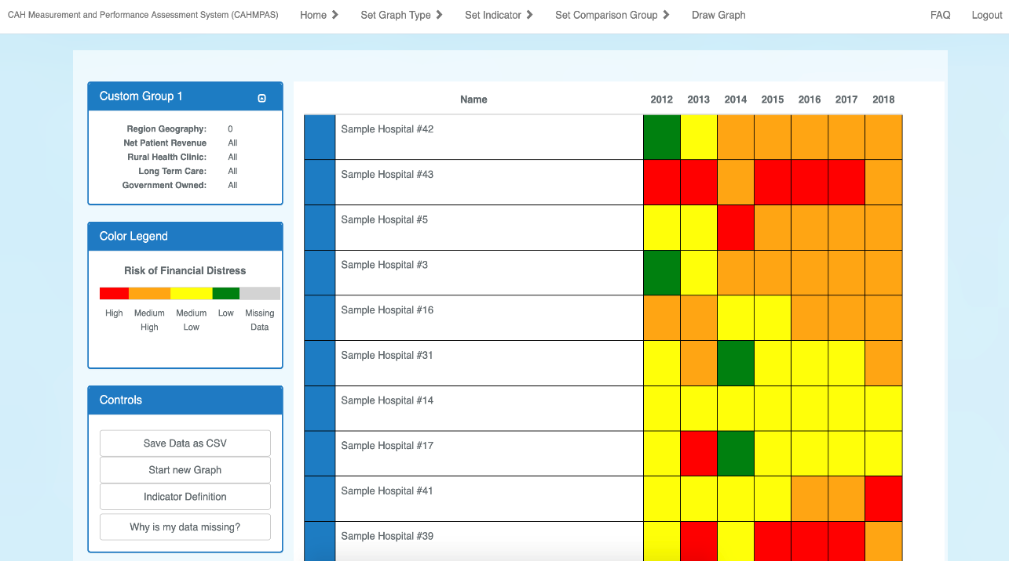
Lesson 1 Introduction
Lesson 2 Comparing Individual Hospitals
Lesson 3 Comparing Group Trends
Lesson 4 Comparing Indicators
Lesson 5 Downloading Data
Lesson 6 Financial Distress Index
2) FDI: Overview
The FDI Model results categorize hospitals into one of four risk categories:
low (green)
medium-low (yellow)
medium-high (orange)
high (red)
Risk categories are presented by year, with the current year blank (grey).
Hospital names
Hovering over a hospital field will show you the town name and state abbreviation.
Predicted distress level by year

Slide 46
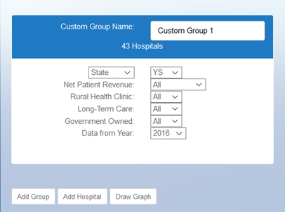
Lesson 1 Introduction
Lesson 2 Comparing Individual Hospitals
Lesson 3 Comparing Group Trends
Lesson 4 Comparing Indicators
Lesson 5 Downloading Data
Lesson 6 Financial Distress Index
3a) Create custom groups to compare
Use automatically generated custom groups from your previous graph or create new groups to compare individual hospitals.
Click “Draw Graph”

Slide 47
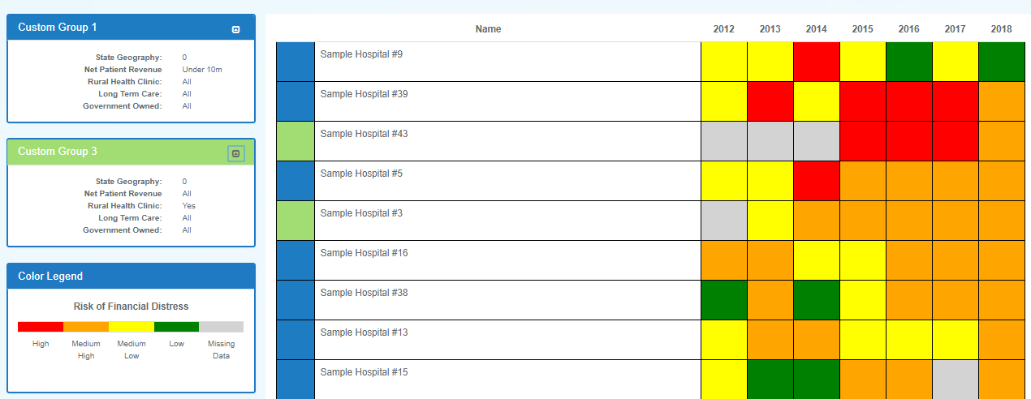
Lesson 1 Introduction
Lesson 2 Comparing Individual Hospitals
Lesson 3 Comparing Group Trends
Lesson 4 Comparing Indicators
Lesson 5 Downloading Data
Lesson 6 Financial Distress Index
3b) Create custom groups to compare
You can create custom groups among the featured categories. For example, you can compare hospitals that have a net patient revenue under 10m to hospitals that have a net patient revenue over 20m.
Custom Group 1
Custom Group 2

Slide 48
Contact Us
CAHMPAS Team
North Carolina Rural Health Research and Policy Analysis Center
Cecil G. Sheps Center for Health Services Research
monitoring@flexmonitoring.org
This tutorial was developed by the Flex Monitoring Team with funding from the Federal Office of Rural Health Policy (FOHRP), Health Resources and Service Administration (HRSA), U.S. Department of Health and Human Services (HHS), under PHS Grant No. U27RH01080. The information, conclusions, and opinions expressed in this tutorial are those of the authors, and no endorsement by FORHP, HRSA, or HHS is intended or should be inferred.

